Slide 1

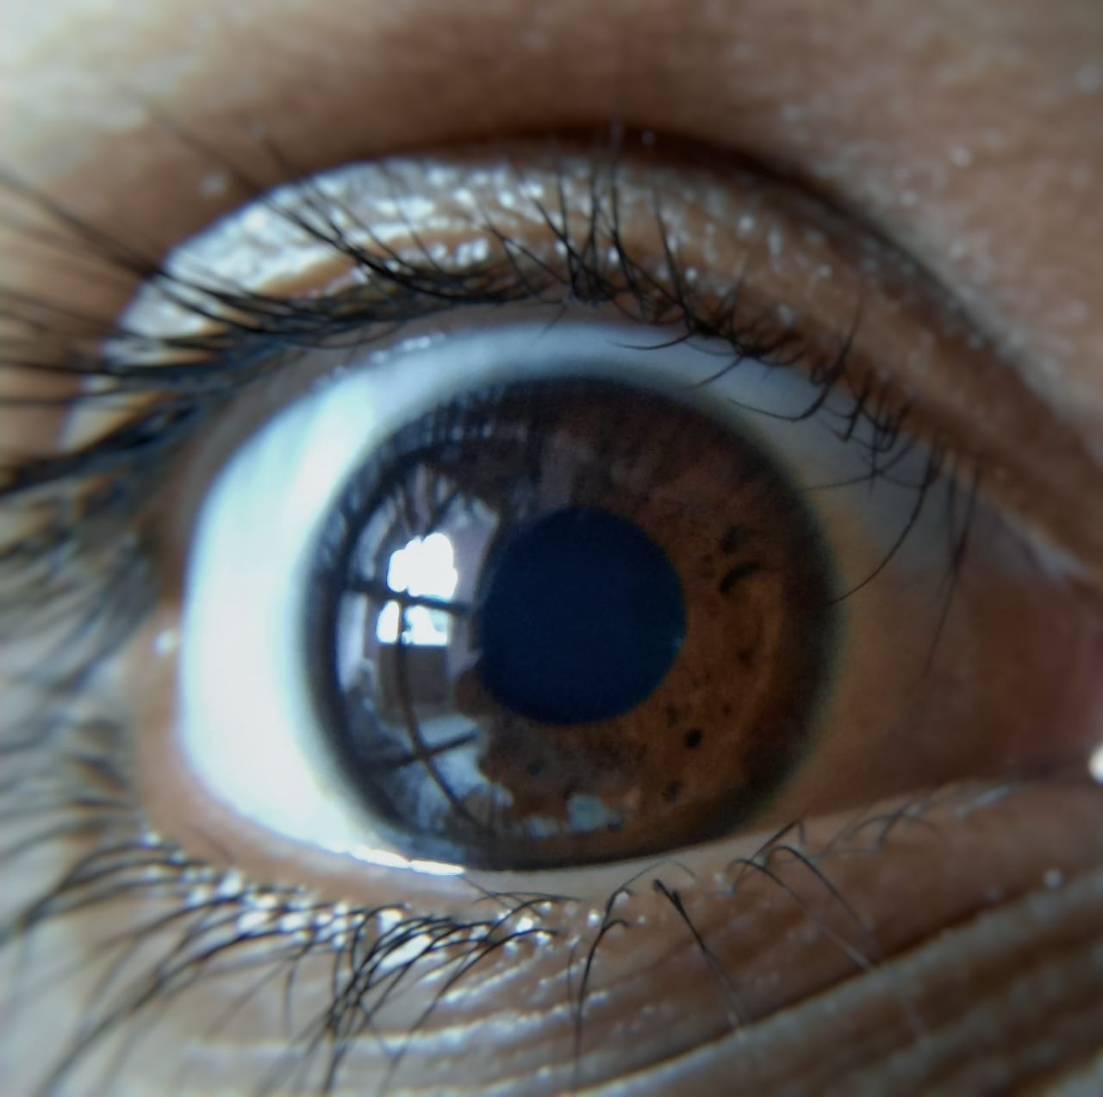
track-I track-i
We make sure that you Blink Once in every 4-5 seconds

Slide 2
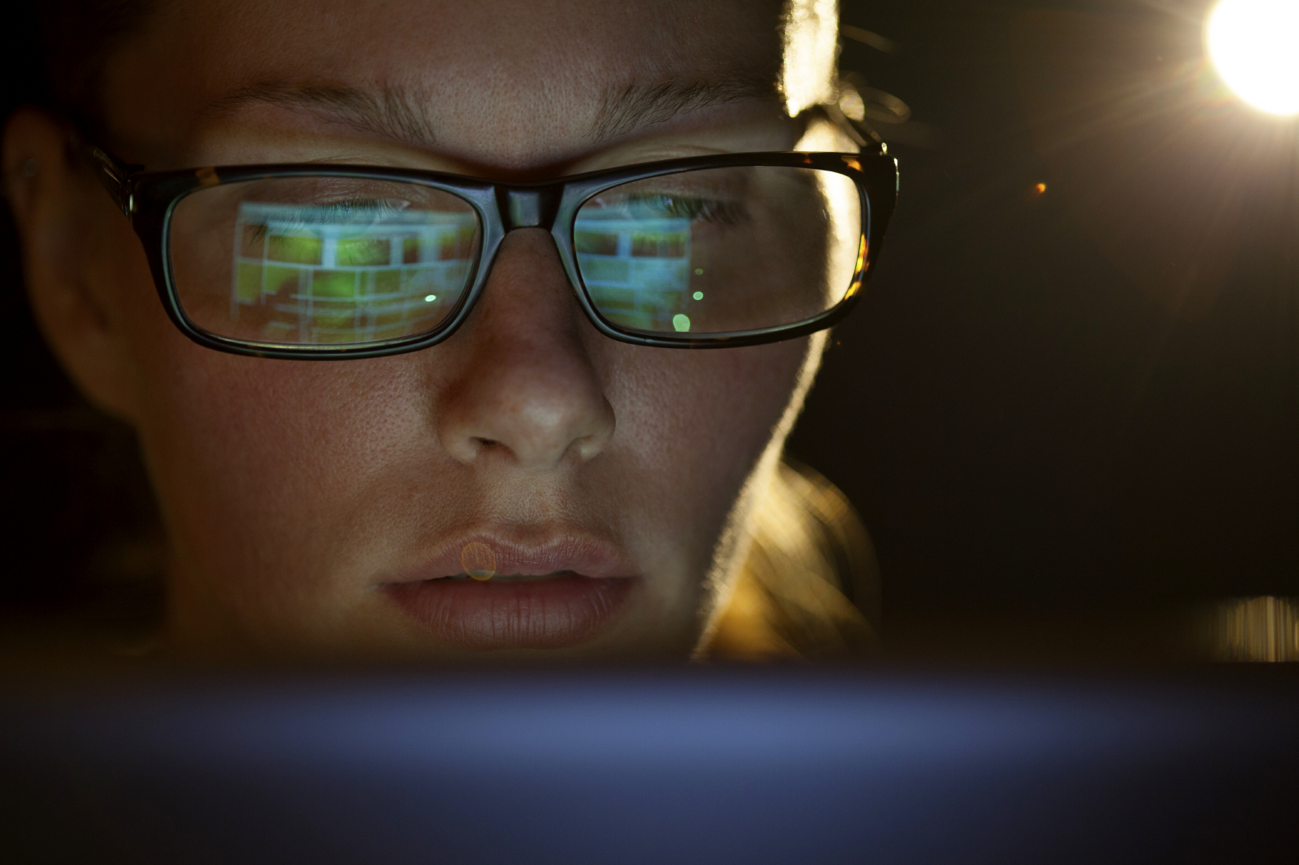
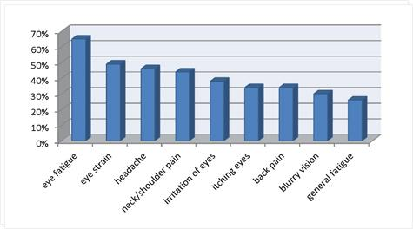
PROBLEM
In the current digital world eye problems have become common. . Increased screen time has caused decrease in average blinking rate. The covid-19 has made the situation worse.

Slide 3
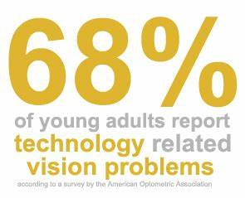
The current Covid situation
The new Normal is:
Work From Home for working adults.
Regular Online Classes For Students

Slide 4
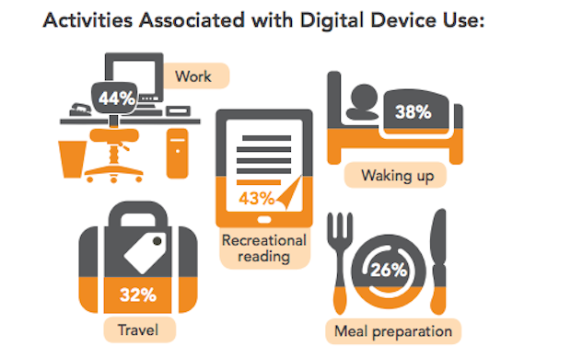
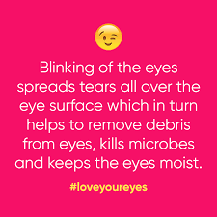
What Research says?
A study says digital screen can decrease eye’s blinking rate by up to two thirds.

Slide 5
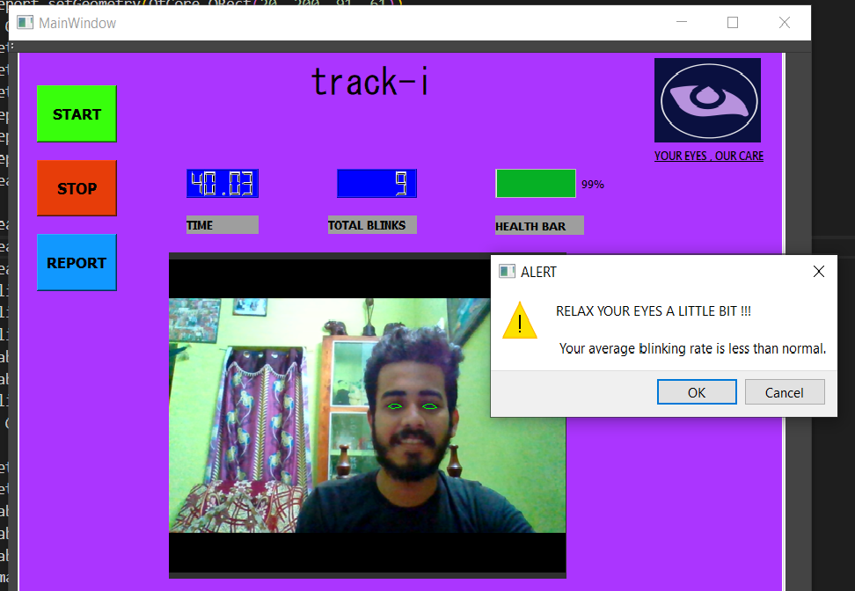

PRODUCT: Track-i
Our Current Product
Tracks Eye movements and counts blinking rate.
Store daily reports separately in a folder
Timer starts only when face is detected so no possibility of incorrect results.
Shows Alert Notification to user in case of below average blinking rate.
Gives a detailed analysis of your blinking rate with graphs and remedies

Slide 6




Software and Libraries Used
Python
Base Programming language
PyQt5
Library used for GUI development.
openCV & dlib
Libraries used for Image Processing and eye & face detection.

Slide 7
Market Analysis and Strategies
Target Market
Students
IT employees/ Adult who rely on devices for work
Collaboration & Partners
Optometrists
Eye Care Hospitals
Customer Acquisition Channels
Partnership with Tech companies and Optometrists
Marketing Campaigns
Avid laptop users and Gamers
Tech Companies
Customer Retention
Reward and Referral System
Constant Upgradation of Services

Slide 8
Course of Action-2020
Develop Blinking gesture controlled actions.
Improve UI
Similar App for Linux Users
Developing similar Apps for phone (Android and IOS) users
Using Google Cloud services to manage storage and improve productivity
Weekly Reports in mail

Slide 9
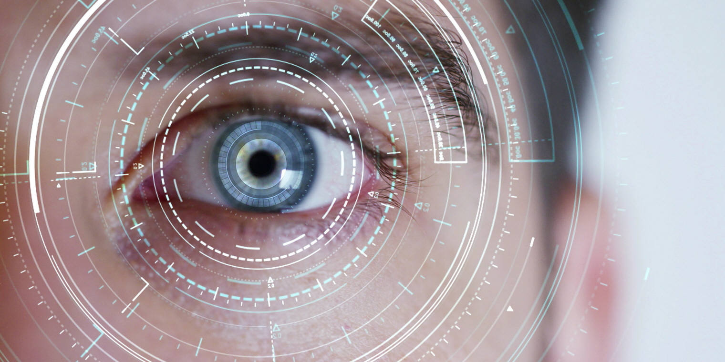
THANK YOU!

